Slide 1
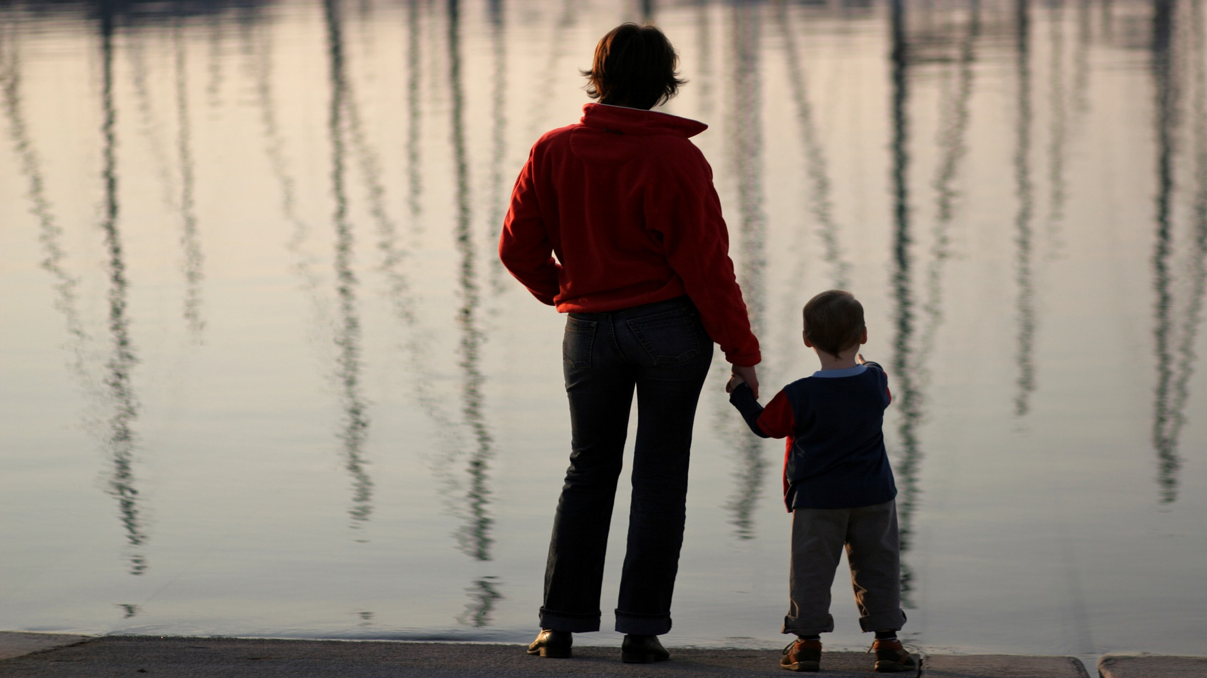

Slide 2
How Was
I Loved?

Slide 3
Intimacy interacts in various ways with the man’s chain mail. Early relationships affect the expectations we have of our present relationships.

Slide 4
Read each statement below. Score each statement as follows:
1 - If you believe that love was likely to be shown to you in this way
0 - If you believe that it was unlikely for love to be shown to you in this way

Slide 5
II. My Mom, before my birth:
1 - If you believe that love was likely to be shown to you in this way
0 - If you believe that it was unlikely for love to be shown to you in this way
Prepared for her pregnancy with me. _____
Carefully chose the male/man who impregnated her. _____

Slide 6
II. My Mom, before my birth:
1 - If you believe that love was likely to be shown to you in this way
0 - If you believe that it was unlikely for love to be shown to you in this way
Chose a good man to be my father. _____
Was loved and supported by her family and was emotionally ready to have a child. _____

Slide 7
II. My Mom, before my birth:
1 - If you believe that love was likely to be shown to you in this way
0 - If you believe that it was unlikely for love to be shown to you in this way
Took care of her body during pregnancy. _____
Had the initiative and social skills to ask others to assist her in the preparations for my arrival. ____

Slide 8
II. My Mom, before my birth:
1 - If you believe that love was likely to be shown to you in this way
0 - If you believe that it was unlikely for love to be shown to you in this way
Prepared my room and decided on a childcare, medical, and nutritional plan for me. _____
Defined my birth as a gift. _____

Slide 9
II. My Mom, before my birth:
1 - If you believe that love was likely to be shown to you in this way
0 - If you believe that it was unlikely for love to be shown to you in this way
Focused on my health, not my gender, as most important. ___

Slide 10
My Mom, after my arrival:
1 - If you believe that love was likely to be shown to you in this way
0 - If you believe that it was unlikely for love to be shown to you in this way
Enjoyed caring for me. ____
Willingly sacrificed her needs and comfort for mine. ____

Slide 11
“Abandoned and rejected by his mother, he was destined to be an angry man.”
Ishmael
Genesis 21:8-20

Slide 12
My Mom, after my arrival:
1 - If you believe that love was likely to be shown to you in this way
0 - If you believe that it was unlikely for love to be shown to you in this way
Allowed me to be myself, rather than who she thought I should be. ____
Set boundaries which taught me to be responsible and kept me safe. _____

Slide 13
My Mom, after my arrival:
1 - If you believe that love was likely to be shown to you in this way
0 - If you believe that it was unlikely for love to be shown to you in this way
14. Modeled good self-control. __
Comforted me when I was hurt. __
Valued me and was realistic about my gifts. __

Slide 14
My Mom, as I grew up, encouraged me:
1 - If you believe that love was likely to be shown to you in this way
0 - If you believe that it was unlikely for love to be shown to you in this way
To understand and consider the spiritual aspects of life. _____
To become independent and allowed me to do things on my own. _____
By providing fair and consistent discipline. _____

Slide 15
My Mom, as I grew up, encouraged me:
1 - If you believe that love was likely to be shown to you in this way
0 - If you believe that it was unlikely for love to be shown to you in this way
By providing an environment that was comfortable for our family and friends. __
By supporting my learning process and by expecting me to do my best. __

Slide 16
My Mom, as I grew up, encouraged me:
1 - If you believe that love was likely to be shown to you in this way
0- If you believe that it was unlikely for love to be shown to you in this way
By demonstrating a strong work ethic. _____
By listening in a non-judgmental fashion. _____
By being a loyal and supportive partner to my Dad. _____

Slide 17
My Mom, as I grew up, encouraged me:
1 - If you believe that love was likely to be shown to you in this way
0 - If you believe that it was unlikely for love to be shown to you in this way
By having a separate love relationship with my Dad. ___
By modeling an optimistic “Can do” attitude. ___
By controlling her anger and “speaking to the truth in love.” ___

Slide 18
My Mom, as I grew up, encouraged me:
1 - If you believe that love was likely to be shown to you in this way
0 - If you believe that it was unlikely for love to be shown to you in this way
By her ability to guide and manage her emotions. ___
By not competing with my dating partners. ___
By developing her own friendships and supportive community. ___

Slide 19
My Mom, as I grew up, encouraged me:
1 - If you believe that love was likely to be shown to you in this way
0 - If you believe that it was unlikely for love to be shown to you in this way
By knowing when to say “No” to my wants. ___

Slide 20
“Conscience is less an inner voice than the memory of a mother’s glance.”
-Robert Brault

Slide 21
My Mom, as I grew up, encouraged me:
1 - If you believe that love was likely to be shown to you in this way
0 - If you believe that it was unlikely for love to be shown to you in this way
By living according to a clear purpose and setting priorities. __
By expressing herself, clearly and directly. __
By playing and laughing with me. __

Slide 22
Add up the score. How many characteristics of love did your mother demonstrate? _____ (out of 34)
How well did she model the intimacy skills that you would need in the future in order to relate well to others?

