Slide 1
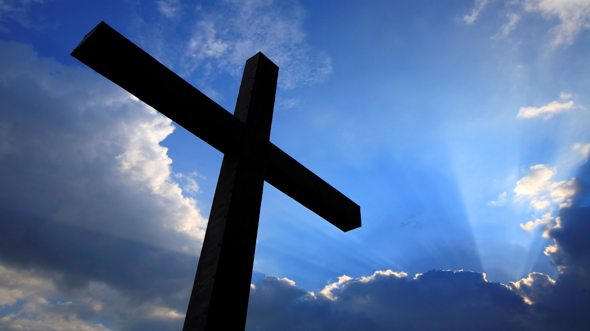

Slide 2
The Ultimate Man

Slide 3
Men were created in the image of God so that they could demonstrate their manhood by making a positive difference in this world. This original design was rejected by men, as they have chosen to assert their will over God’s plan for their lives. This anti-God process is called our shadow (sin nature).

Slide 4
A man:
Is highly valued by God because of the special way God designed him to be.
Is given a spirit which gives him the special capacity to have a relationship with God.
Has the capability to choose whether he will have a relationship with God.

Slide 5
A man:
Is unable to develop to his full potential, because he has chosen to replace God with his own “will.”
Denies the Spirit’s presence in his life by letting the shadow control his decision-making.
Hinders his relationships by letting the selfish nature of the shadow take control.

Slide 6
“Whatever disunites man from God, also disunites man from man.”
-Edmund Burke

Slide 7
A man:
Is so loved by God that He desires to save him from his disruptive impulses and eternal death.
Is so in need of a Savior that God sent the “ultimate man,” Jesus Christ, to live on earth, and sacrifice His life, so that a man’s spirit can have a relationship with God.
Needs to accept what Christ has done, making it possible for his spirit to commune with God on a daily basis and receive guidance from Him.

Slide 8
A man:
Can be empowered by God, become a knight, and make the world better.

Slide 9
The “ultimate man,” Jesus Christ, modeled how we can live.
He was always aware of the shadow’s presence in others. He knew that the shadow’s influence:
Would lead an associate (Judas) to plot his death.
Would show up in His friend Peter’s life.
Could be found in religious men.

Slide 10
The “ultimate man,” Jesus Christ, modeled how we can live.
He was always aware of the shadow’s presence in others. He knew that the shadow’s influence:
Would seem to offer personal comfort.
Would offer significant power.
Would distort scripture.
Would damage creation.

Slide 11
Demon-Possessed
Man
Matthew 8:28-32

Slide 12
The “ultimate man,” Jesus Christ, modeled how we can live.
He was always aware of the shadow’s presence in others. He knew that the shadow’s influence:
Would be found in government.
Would support suffocating rules.

Slide 13
The “ultimate man,” Jesus Christ, modeled how we can live.
He understood that submission to God’s will gave Him great power over the shadow’s influence and presence.
He used memorized scripture to guide his life.
He chose to follow God the Father’s desires over His own.
He prayed and worshipped God regularly.

Slide 14
The “ultimate man,” Jesus Christ, modeled how we can live.
He understood that submission to God’s will gave Him great power over the shadow’s influence and presence.
He honored God by following His call to help others.
He developed supportive relationships.

Slide 15
The “ultimate man,” Jesus Christ, modeled how we can live.
Jesus knew when and how to use His armor with others.
Jesus dealt with His chain mail and put His family history in perspective.
Jesus demonstrated the value of each person whom He came in contact with.

Slide 16
The “ultimate man,” Jesus Christ, modeled how we can live.
Jesus guided His instincts.
Jesus used His mind well. (King, Warrior, Lover, Friend)
Jesus controlled His emotions, while feeling them completely.
Jesus was able to interact with the leaders of present-day thought, while introducing new ideas that had never been heard before.

Slide 17
What do you believe regarding God and His Son, Jesus Christ? A man makes a choice regarding who or what he believes in or doesn’t believe in.

