Slide 1
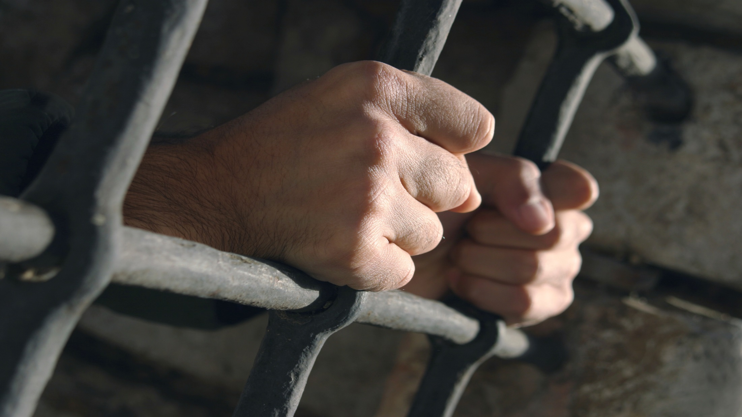

Slide 2
Loving Another

Slide 3
Manhood Challenge 6 encourages a man to pursue intimacy, instead of isolation.¹ The process of developing intimacy can be quite challenging, as a man chooses to enter a territory where relationships are not as simple. A knight establishes several different types of intimate friendships. The process of creating an intimate relationship with a wife is similar to the way it is created within the context of male friendships.
¹ These stages of development were first described in the work of Erik Erikson.

Slide 4
“Build for your team a feeling of oneness, of dependence on one another and of strength to be derived by unity.”
-Vince Lombardi

Slide 5
A knight moves from exploring different relationships to choosing an individual relationship in which to invest himself more fully.
The knight:
Realized that by saying “Yes” to one relationship, he is also saying “No” to a different relationship.
Accepts that he will face challenges within this relationship that another relationship would not have.

Slide 6
A knight moves from exploring different relationships to choosing an individual relationship in which to invest himself more fully.
The knight:
Must control his spandex impulse to avoid the difficult relational work that is ahead.

Slide 7
The knight commits to creating a secure relationship for his partner.
He tries to understand her armor and encourages her to be vulnerable in her relationship with him.
He is determined to see her as she is, not as he wants her to be.
He does not displace his previously unmet needs on her, but deals with these past deficits himself.

Slide 8
The knight commits to creating a secure relationship for his partner.
He invites her input regarding how they spend their time together.
He listens at deeper levels, for the feelings that she is trying to express.
He shares his frustration and anger in a loving manner.
He apologizes for his failures and works hard not to repeat them.

Slide 9
“Now the man and his wife were both naked, but they felt no shame.”
Adam and Eve
Genesis 2:25

Slide 10
A knight recognizes that he is as responsible for the creation of a healthy relationship as she is.
The immaturity that he sees in her is also in him.
He needs to continue to grow personally in order to encourage her growth process.
He understands that accepting their differences is more helpful than trying to change her.

Slide 11
A knight recognizes that he is as responsible for the creation of a healthy relationship as she is.
He focuses on the positive parts of the relationship.
His core will grow in strength as he gives of himself to her.

