Slide 1
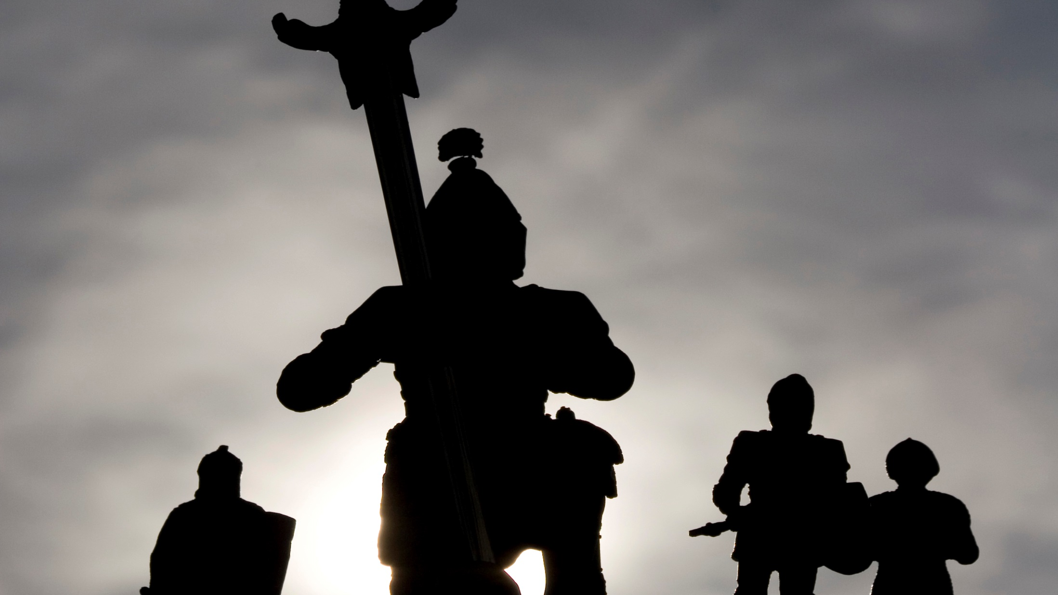

Slide 2
Getting There

Slide 3
In the previous trail, we described four different types of identity states that a male will use to pose as a man. The final identity state occurs when a man achieves knighthood. In order for a knight to form his identity, he needs a strong support system, a challenge that he responds to courageously, self-awareness, and divine inspiration.

Slide 4
The chief identity supports (or trail markers) that contribute to the development of a male’s manhood are:
A tribe that offers a young man:
Medical and nutritional resources to assist his body in becoming its best.

Slide 5
A tribe that offers a young man:
An educational system that teaches basic skills and encourages socialization.
Guidance regarding what is expected of a man.

Slide 6
A tribe that offers a young man:
A recreational system that is used to refuel, to meet others, to exercise, and to develop physical strength.
The availability of peer interaction.

Slide 7
“What I am proud of is I have searched for the best of me and I have been a team man without fail.”
-Jonny Wilkinson

Slide 8
A tribe that offers a young man:
A legal system which supports laws that are good for the whole community.
Encouragement to develop the unique potential that is a part of his cultural traditions.

Slide 9
A tribe that offers a young man:
Opportunities to discover God, and to define his values and his ethics.

Slide 10
Committed elders and role models who teach young males to:
Learn from the difficulties and imperfections of their past and develop new strengths.
Practice survival skills within the forest.

Slide 11
Committed elders and role models who teach young males to:
Behave like their role models and follow manhood principles, which will serve to help others strengthen their core.
Honor their achievement of knighthood by following their unique calling.

Slide 12
Committed elders and role models who teach young males to:
Achieve balance in their perceptions, by both thinking and feeling in manly ways.
Live as positive influencers and givers within their own forest, as they develop the skills to become role models in the forest.

Slide 13
James
Matthew 10:1-42

Slide 14
Principles, which serve as self-prescribed rules, bringing growth and stability to the knight and those who are within his influence.
The inner voice of the soul which directs the knight to focus on the “bigger picture,” to develop a viewpoint which includes God, and to follow what he has identified as his life’s purpose.

Slide 15
His spirituality, which comes alive through a relationship with Christ. He can seek God’s guidance on a daily basis in better ways.
Once the Spirit comes alive in a man, he seeks God daily for guidance, follows God’s special call for him, and serves God by helping others.

Slide 16
His spirituality, which comes alive through a relationship with Christ. He can seek God’s guidance on a daily basis in better ways.
As a result of the resurrection of the man’s spirit, the soul’s need for complete meaning in life is met.

Slide 17
These five manhood trail markers assist the male by pointing the way through the forest toward the quest of becoming a man.

Slide 18
By following the trail markers, a man is led into knighthood. Due to his strength, a knight can participate in an honest self-evaluation process.
He:
Uses his manly energy to search the various aspects of himself that he can improve.

Slide 19
By following the trail markers, a man is led into knighthood. Due to his strength, a knight can participate in an honest self-evaluation process.
He:
Develops his giftedness by seeking increasingly challenging tasks.

Slide 20
By following the trail markers, a man is led into knighthood. Due to his strength, a knight can participate in an honest self-evaluation process.
He:
Knows that there is always at least one more personal area in which he could grow.

Slide 21
By following the trail markers, a man is led into knighthood. Due to his strength, a knight can participate in an honest self-evaluation process.
He:
Focuses on the development of his strength, rather than on the repairs that are required when he is weak.

Slide 22
By following the trail markers, a man is led into knighthood. Due to his strength, a knight can participate in an honest self-evaluation process.
He:
Views difficulties as opportunities which help him recognize the areas where he can become stronger, as he humbly discovers new solutions.

Slide 23
By following the trail markers, a man is led into knighthood. Due to his strength, a knight can participate in an honest self-evaluation process.
He:
Seeks supportive and positive relationships from which the feedback that he receives brings him opportunities for growth.

Slide 24
By following the trail markers, a man is led into knighthood. Due to his strength, a knight can participate in an honest self-evaluation process.
He:
Views his manhood success as an obligation to mentor others.

Slide 25
By following the trail markers, a man is led into knighthood. Due to his strength, a knight can participate in an honest self-evaluation process.
He:
Understands that the shadow can only be completely controlled by the empowerment of the man’s spirit by God.

Slide 26
By following the trail markers, a man is led into knighthood. Due to his strength, a knight can participate in an honest self-evaluation process.
He:
Submits to God, as he follows His truth and guidance.

