Slide 1
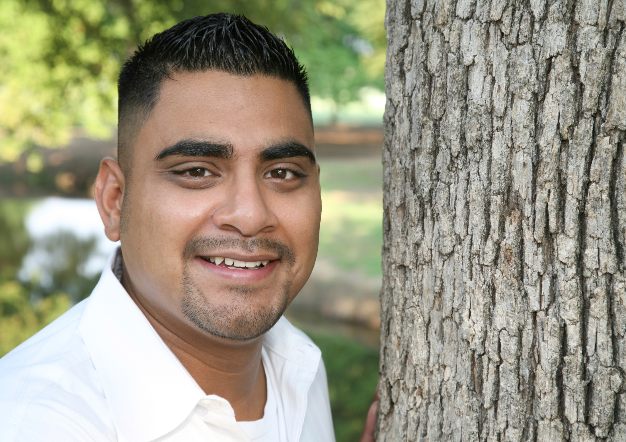

Slide 2
Being The True You

Slide 3
A knight demonstrates the strength of his character by how often he chooses to act in an authentic manner. He does this by consistently putting his manhood principles into practice. He builds his life on belief pillars that last.

Slide 4
Pillar 7 states: Only the true you will get you through. There are three ways that a male can choose to present himself to others:

Slide 6
Pillar 7 states: Only the true you will get you through. There are three ways that a male can choose to present himself to others:
The false self: This is an image that is shown to others which:
Is not based on strength, integrity, or courage.
Responds to the convenience of the moment.

Slide 7
The false self: This is an image that is shown to others which:
Can confuse the male regarding who he really is.
Acts “as if,” by putting on different social masks.
Without the true self, will lead to an individual becoming more dishonest.

Slide 8
The false self: This is an image that is shown to others which:
Causes others not to trust him.
Fails to do the challenging work of expressing his true self.
Does not enable the man to live according to any values.
Has a primary motivation to protect and hide.

Slide 9
The false self: This is an image that is shown to others which:
Is harder to change, the longer it exists.
Describes a spandex male.
Is utilized by the shadow.

Slide 10
Pillar 7 states: Only the true you will get you through. There are three ways that a male can choose to present himself to others:
The false self:
The true self:
Acts in the ways that God has ordained him to be.
Demonstrates his unique set of strengths, gifts, interests, skills and abilities.

Slide 11
Pillar 7 states: Only the true you will get you through. There are three ways that a male can choose to present himself to others:
The false self:
The true self:
Organizes the various messages within the knight and makes decisions in a manner that supports his purpose and character.

Slide 12
Pillar 7 states: Only the true you will get you through. There are three ways that a male can choose to present himself to others:
The false self:
The true self:
Takes ownership of his wrong actions, and when necessary, asks for forgiveness and attempts to restore relationships that are broken.

Slide 13
Pillar 7 states: Only the true you will get you through. There are three ways that a male can choose to present himself to others:
The false self:
The true self:
Purposefully chooses to put aside his needs in order to care for others.

Slide 14
Pillar 7 states: Only the true you will get you through. There are three ways that a male can choose to present himself to others:
The false self:
The true self:
Focuses on his calling and chooses his goals with God’s will in mind.

Slide 15
He was true to himself and his calling, impacting the understanding of the round table.
Eldad
Numbers 11:26-30

Slide 16
Pillar 7 states: Only the true you will get you through. There are three ways that a male can choose to present himself to others:
The false self:
The true self:
By choosing to live according to his true self, instead of his false self, the knight is able to live by:

Slide 17
By choosing to live according to his true self, instead of his false self, the knight is able to live by:
Pillar 8: A man shapes the forest more than the forest shapes the man. He does not compromise his principles, but bends the forest to his will.

Slide 19
By choosing to live according to his true self, instead of his false self, the knight is able to live by:
Pillar 9: The best way for a man to predict his future is to create it. He follows his “inner voice” and God’s call for him by making deliberate choices for his future.

Slide 21
By choosing to live according to his true self, instead of his false self, the knight is able to live by:
Pillar 10: A man accepts that to live is to be challenged through crisis and hardship. He strengthens his identity by dealing with forest difficulties.

Slide 23
By choosing to live according to his true self, instead of his false self, the knight is able to live by:
Pillar 11: A man never stands alone unless he is taking a stand. He considers his relationships to be a true measure of his wealth in the forest setting and uses them for support.

Slide 25
“No man is wise enough by himself.”
-Titus Maccius Plautus

Slide 26
By choosing to live according to his true self, instead of his false self, the knight is able to live by:
Pillar 12: A man knows when to say “I was wrong” and humbly faces his errors. He recognizes the existence of his shadow and takes ownership of his weaknesses.

Slide 28
By choosing to live according to his true self, instead of his false self, the knight is able to live by:
Pillar 13: A man does not always get it right the first time, but keeps on trying until he does. He recognizes that starting over again, after failure, is his only manly option.

Slide 30
By choosing to live according to his true self, instead of his false self, the knight is able to live by:
Pillar 14: A man lives by his principles. He avoids believing in anything false, as he seeks to live a truthful lifestyle.

Slide 32
By choosing to live according to his true self, instead of his false self, the knight is able to live by:
Pillar 15: A man submits to an authority beyond himself. He answers his soul’s question, “What are you going to do with the concept of God?”

Slide 34
Sometimes a knight temporarily uses a performance “self.” This is necessary when the decision to share his own struggles can harm others. He temporarily puts aside his feelings, in a knowledgeable and insightful way, for the greater good of the other person(s).

