Slide 1
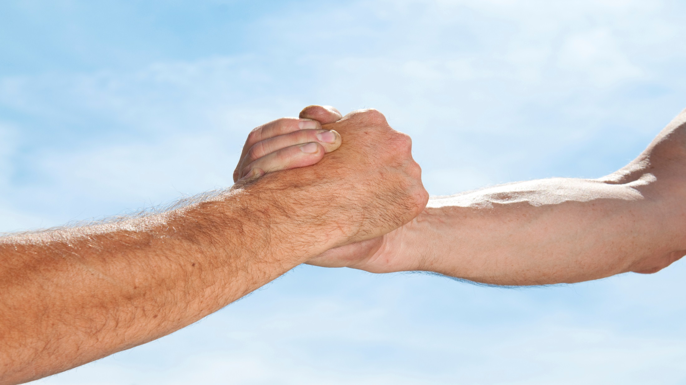

Slide 2
Wounds

Slide 3
News Flash: Life is not always fair. Everyone experiences some form of pain. There are two ways that people deal with the fact that no one gets through life without being wounded in some way.
A. A man adapts by:
1. Processing his emotional grief that he experiences.
2. Learning from each painful event he experiences.

Slide 4
News Flash: Life is not always fair. Everyone experiences some form of pain. There are two ways that people deal with the fact that no one gets through life without being wounded in some way.
A. A man adapts by:
3. Developing new strengths.
4. Helping others who have similar wounds.
5. Relying on God’s love and power.

Slide 5
News Flash: Life is not always fair. Everyone experiences some form of pain. There are two ways that people deal with the fact that no one gets through life without being wounded in some way.
B. A male becomes a victim by:
1. Feeling crushed and giving up.
2. No longer pursuing his dreams.
3. Expecting others to help him succeed.

Slide 6
News Flash: Life is not always fair. Everyone experiences some form of pain. There are two ways that people deal with the fact that no one gets through life without being wounded in some way.
B. A male becomes a victim by:
4. Using his anger to create other victims.
5. Denying God’s presence and purpose in his life.

Slide 7
People act in various ways as a result of choosing not to deal with their forest wounds. People who have not processed their pain will create wounds in others:
A. A man has difficulty giving to others in nurturing ways if he has not been nurtured himself.
B. Some people are competitive about obtaining the necessities of life because they believe there are not enough resources to go around.

Slide 8
People act in various ways as a result of choosing not to deal with their forest wounds. People who have not processed their pain will create wounds in others:
C. Some people devalue themselves so that any closeness in their relationships creates negative comparisons:
1. If I feel like I am not a person who has value, I expect you to reject me.
2. If I feel like I am not valuable and you like me, you must make poor choices regarding friendships.

Slide 9
People act in various ways as a result of choosing not to deal with their forest wounds. People who have not processed their pain will create wounds in others:
C. Some people devalue themselves so that any closeness in their relationships creates negative comparisons:
3. If I feel like I am not valuable, I will feel my lack of value even more when I am in the presence of others, so I must maintain distance from others.

Slide 10
People act in various ways as a result of choosing not to deal with their forest wounds. People who have not processed their pain will create wounds in others:
C. Some people devalue themselves so that any closeness in their relationships creates negative comparisons:
4. If I feel like I am not valuable, I might as well act the part because it is easier than hoping for something that will not happen.

Slide 11
People act in various ways as a result of choosing not to deal with their forest wounds. People who have not processed their pain will create wounds in others:
C. Some people devalue themselves so that any closeness in their relationships creates negative comparisons:
5. If I feel like I am not valuable, I need to constantly earn your attention. Therefore, I must please you at the cost of being who I really am.

Slide 12
People act in various ways as a result of choosing not to deal with their forest wounds. People who have not processed their pain will create wounds in others:
D. People have chosen to give in to their shadows by choosing to manipulate, dominate, control and abuse others.

Slide 13
The rest of the community was not safe because greed won out over the rules.
(Joshua 7:19-22)

Slide 14
People act in various ways as a result of choosing not to deal with their forest wounds. People who have not processed their pain will create wounds in others:
E. People live only for the moment and do not care about anything beyond the pleasure they receive.
F. People don’t recognize that their imperfections cause them to be too self-focused which causes conflict and hurts others.
G. People expect others to heal their wounds and meet all of their needs.

Slide 15
While a man is dealing with the ways that life has treated him unfairly, the forest throws even more challenges at him:
There are floods, earthquakes, fires, pollution, snow, ice, tornadoes and droughts, all of which make a person’s daily existence more difficult.
There are limited resources.
There is often a disconnect between people’s needs and the availability of forest resources.

Slide 16
While a man is dealing with the ways that life has treated him unfairly, the forest throws even more challenges at him:
There are diseases that attack healthy people.
As humans, we sometimes choose to hurt the environment by making ecology inconvenient. The environment gradually adapts to the damage we create by becoming less hospitable.
Random acts of violence by others.

Slide 17
The forest wounds us even further by selling us negatively-focused ideas that contradict manhood:
You can only live well by taking care of yourself.
Rules, standards and accountability must be avoided in order to protect my freedom.
My value is determined by what I do, not who I am.
Manhood is determined by age, physical strength and sexual prowess.

Slide 18
The forest wounds us even further by selling us negatively-focused ideas that contradict manhood:
E. Whatever has been done in the past predetermines a person’s future.
F. The power to effectively deal with forest challenges is unrelated to a man’s ability to follow God’s guidance and is more about the strength he has to handle them on his own.
G. What really counts in life can be seen, controlled,
manipulated and measured. You should ignore the spiritual world.

Slide 19
The forest wounds us even further by selling us negatively-focused ideas that contradict manhood:
H. The nature of the forest is random and chaotic, and purely based on chance.

