Slide 1
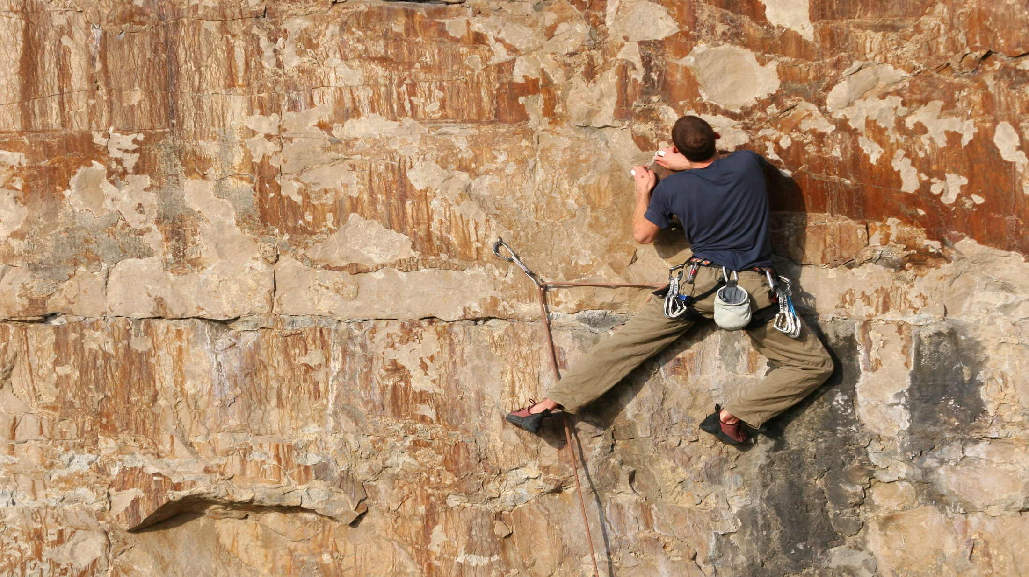

Slide 2
3 Key Choices That A Man Must Make

Slide 3
What separates a man from simply being good at something to becoming his best has a lot to do with what he does with his choices.

Slide 4
A man who is true to his spiritual beliefs and whose integrity is strong is a man who can be relied on.
(John 1:45-51)

Slide 5
What separates a man from simply being good at something to becoming his best has a lot to do with what he does with his choices.
A. A man must choose which habits will define him. A man’s habits:
1. Should be evaluated regarding how helpful they are to his ability to live an efficient and productive life.
2. May be positive and yet not always the right choice for each situation.
3. May need to be changed because of living in the forest, as it is dynamic and is constantly changing.

Slide 6
What separates a man from simply being good at something to becoming his best has a lot to do with what he does with his choices.
A. A man must choose which habits will define him. A man’s habits:
4. Must be guided in ways that reflect his purpose and values.
5. Must encourage him to express his emotions and care for others.
6. Are not always good; there is often a need to develop new, more positive ruts.

Slide 7
What separates a man from simply being good at something to becoming his best has a lot to do with what he does with his choices.
A. A man must choose which habits will define him. A man’s habits:
7. Should encourage positive relationships, adaptive skills, personal development and physical self-care.
8. Can be changed, but if they have been practiced for a long time, he will need God’s empowerment in order to change them.

Slide 8
What separates a man from simply being good at something to becoming his best has a lot to do with what he does with his choices.
B. A knight must respond to God’s call. A man’s calling:
1. Is from God. It fits so perfectly with God’s unique genetic design that he must develop his full potential in order to be completely satisfied.
2. Will always reflect God’s message of love to a hurting world.
3. Will specifically apply his giftedness in ways that enhance others.

Slide 9
What separates a man from simply being good at something to becoming his best has a lot to do with what he does with his choices.
B. A knight must respond to God’s call. A man’s calling:
4. Will provide him with a sense of meaning and purpose.
5. Allows him to express his gratitude to God for His guidance and love, when he follows it.
6. Will require him to periodically leave his comfort zone, as he moves into the transparent stage of giving and growing.

Slide 10
What separates a man from simply being good at something to becoming his best has a lot to do with what he does with his choices.
B. A knight must respond to God’s call. A man’s calling:
7. Provides comfort to him when he looks back on his life as a knight.
8. Will be fulfilled if he has developed a good support system, a learning spirit, and regular dialogue with God.
9. Will help him change the world, when combined with the efforts of other men who are willingly following their calling.
10. Will allow him, at the end of his life, to hear the message from God, “Well done, my good and faithful servant.”

Slide 11
What separates a man from simply being good at something to becoming his best has a lot to do with what he does with his choices.
C. A man must choose the relationships that are important to him. He must have the willingness:
1. To do the hard work that is necessary to maintain his marital relationship.
2. To model a grace-filled attitude, a forgiving spirit and a principled lifestyle to his children which will help them become their best.
3. To have conflicts with others; he must learn to look at what he has done wrong, apologize and seek forgiveness while confronting others who need this feedback.

Slide 12
What separates a man from simply being good at something to becoming his best has a lot to do with what he does with his choices.
C. A man must choose the relationships that are important to him. He must have the willingness:
4. To walk away from relationships which are harmful or negative, or which require him to make choices that are unethical or compromise his values.
5. To engage with others by smiling, complimenting them, playing with them or just having fun.
6. To contribute to the lives of others in supportive ways, making them better off for having met him.

Slide 13
What separates a man from simply being good at something to becoming his best has a lot to do with what he does with his choices.
C. A man must choose the relationships that are important to him. He must have the willingness:
7. To practice relationship skills by sharing his feelings honestly and listening to others.
8. To do the tough job of prioritizing his relationships, which then allows him to invest his time in the people who are the most significant to him.
9. To worship with those who will encourage, strengthen and challenge his spiritual walk with God.

Slide 14
What separates a man from simply being good at something to becoming his best has a lot to do with what he does with his choices.
C. A man must choose the relationships that are important to him. He must have the willingness:
10. To maintain his commitment to his family, friends and campfire group and to be an ever-present source of strength by contributing positively to their lives.
11. To strengthen his relationship with Jesus Christ by reading the Bible and communicating with God through prayer on a daily basis.

