Slide 1
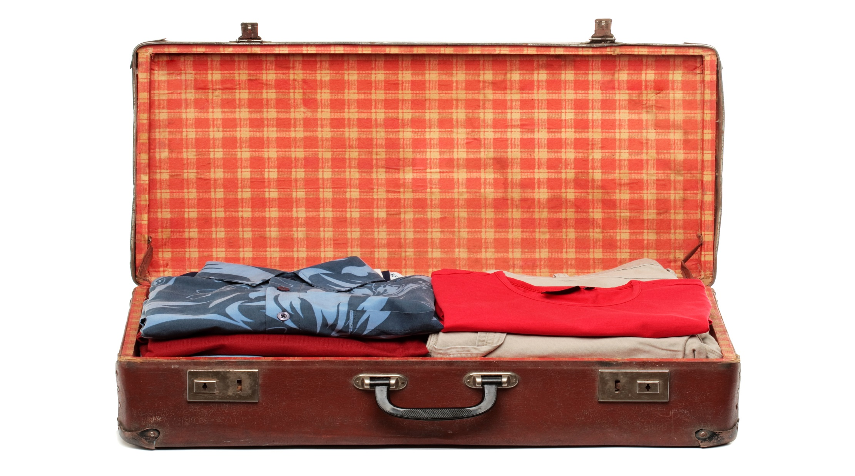

Slide 2
What Would I Miss?

Slide 3
This Trail begins as you read the following letter from your physician:
Dear _________________,
We are sorry to inform you that your test results have come back positive. Unfortunately, there is nothing more at this time that can be done for you. The normal course of this rare illness is three weeks. You will feel fine for three weeks and will experience very few symptoms. From there on, your health will decline quickly and you will pass away within 24 hours. I am sorry to be the bearer of this bad news. We wish you well.
Sincerely,
Dr. Quack

Slide 4
When you read this letter, what messages are going to your various internal elements? How does this type of message sensitize you to the relationships in your life? Check (✓) any response you think you might have if you were to receive such a letter. You may not know the answers to all of these questions, but thinking through the possibilities will help you to clarify where you are at, as a knight, regarding your eventual death. Share what you would expect to occur as you anticipate death by checking (✓) the options below that you believe would apply to you.
A. How would your armor respond?
Would you be more open and vulnerable? ___
Do you think that you would isolate yourself? ___
Would you want to talk more to others? ___
Would you rather be left alone? ___

Slide 5
Before he had to deal with his death, he fought for a longer life. But death cannot be delayed forever.
(2 Kings 20:1-11)

Slide 6
When you read this letter, what messages are going to your various internal elements? How does this type of message sensitize you to the relationships in your life? Check (✓) any response you think you might have if you were to receive such a letter. You may not know the answers to all of these questions, but thinking through the possibilities will help you to clarify where you are at, as a knight, regarding your eventual death. Share what you would expect to occur as you anticipate death by checking (✓) the options below that you believe would apply to you.
B. What messages would your chain mail send you?
Do you have any memories related to someone you knew who either died well or poorly? __
Do you have the strength to handle this knighthood challenge? ___
What are your beliefs? Do they comfort you, as you think about your death? ___
Are they of no comfort to you? ___

Slide 7
When you read this letter, what messages are going to your various internal elements? How does this type of message sensitize you to the relationships in your life? Check (✓) any response you think you might have if you were to receive such a letter. You may not know the answers to all of these questions, but thinking through the possibilities will help you to clarify where you are at, as a knight, regarding your eventual death. Share what you would expect to occur as you anticipate death by checking (✓) the options below that you believe would apply to you.
C. What messages would your body send you from its various elements?
Would you have an instinctual tendency to want to run from your body’s messages through the use of denial? ___
Would you get a second opinion on your diagnosis? ___
Would you take care of your body until the end? ___
What feelings do you have about the end of your life? ___

Slide 8
When you read this letter, what messages are going to your various internal elements? How does this type of message sensitize you to the relationships in your life? Check (✓) any response you think you might have if you were to receive such a letter. You may not know the answers to all of these questions, but thinking through the possibilities will help you to clarify where you are at, as a knight, regarding your eventual death. Share what you would expect to occur as you anticipate death by checking (✓) the options below that you believe would apply to you.
C. Would your sexual interest decrease? ___
Would it stay the same? ___
Would it intensify? ___

Slide 9
When you read this letter, what messages are going to your various internal elements? How does this type of message sensitize you to the relationships in your life? Check (✓) any response you think you might have if you were to receive such a letter. You may not know the answers to all of these questions, but thinking through the possibilities will help you to clarify where you are at, as a knight, regarding your eventual death. Share what you would expect to occur as you anticipate death by checking (✓) the options below that you believe would apply to you.
D. List the activities that would be enjoyable to you during your final days.
How would this news change any plans that you made prior to this time?

Slide 10
When you read this letter, what messages are going to your various internal elements? How does this type of message sensitize you to the relationships in your life? Check (✓) any response you think you might have if you were to receive such a letter. You may not know the answers to all of these questions, but thinking through the possibilities will help you to clarify where you are at, as a knight, regarding your eventual death. Share what you would expect to occur as you anticipate death by checking (✓) the options below that you believe would apply to you.
E. It is important to be aware of your instinct to avoid pain. List the top five things that you believe will create emotional pain for you as you anticipate your death.

Slide 11
When you read this letter, what messages are going to your various internal elements? How does this type of message sensitize you to the relationships in your life? Check (✓) any response you think you might have if you were to receive such a letter. You may not know the answers to all of these questions, but thinking through the possibilities will help you to clarify where you are at, as a knight, regarding your eventual death. Share what you would expect to occur as you anticipate death by checking (✓) the options below that you believe would apply to you.
F. When you read this letter, what thoughts did you have? What part of the plan you have for your life feels incomplete?
What parts of life would you miss?

Slide 12
When you read this letter, what messages are going to your various internal elements? How does this type of message sensitize you to the relationships in your life? Check (✓) any response you think you might have if you were to receive such a letter. You may not know the answers to all of these questions, but thinking through the possibilities will help you to clarify where you are at, as a knight, regarding your eventual death. Share what you would expect to occur as you anticipate death by checking (✓) the options below that you believe would apply to you.
G. How well have you prepared the plans for your estate so that the people who are left behind are taken care of?
I am well prepared. ___
I just need to finalize a few parts of my plan. ___
I don’t have much of a plan. ___

Slide 13
When you read this letter, what messages are going to your various internal elements? How does this type of message sensitize you to the relationships in your life? Check (✓) any response you think you might have if you were to receive such a letter. You may not know the answers to all of these questions, but thinking through the possibilities will help you to clarify where you are at, as a knight, regarding your eventual death. Share what you would expect to occur as you anticipate death by checking (✓) the options below that you believe would apply to you.
H. Are there any unresolved issues in your relationships? Yes ___ No ___
What and with whom?

Slide 14
When you read this letter, what messages are going to your various internal elements? How does this type of message sensitize you to the relationships in your life? Check (✓) any response you think you might have if you were to receive such a letter. You may not know the answers to all of these questions, but thinking through the possibilities will help you to clarify where you are at, as a knight, regarding your eventual death. Share what you would expect to occur as you anticipate death by checking (✓) the options below that you believe would apply to you.
I. Identify the people to whom you would like to give specific messages. Write them below.
Name: _______________ Message: ___________________
Name: _______________ Message: ___________________
Name: _______________ Message: ___________________

Slide 15
When you read this letter, what messages are going to your various internal elements? How does this type of message sensitize you to the relationships in your life? Check (✓) any response you think you might have if you were to receive such a letter. You may not know the answers to all of these questions, but thinking through the possibilities will help you to clarify where you are at, as a knight, regarding your eventual death. Share what you would expect to occur as you anticipate death by checking (✓) the options below that you believe would apply to you.
J. Over the next three weeks prior to your death, as you look back on your life, in which areas do you have the biggest regrets?

Slide 16
When you read this letter, what messages are going to your various internal elements? How does this type of message sensitize you to the relationships in your life? Check (✓) any response you think you might have if you were to receive such a letter. You may not know the answers to all of these questions, but thinking through the possibilities will help you to clarify where you are at, as a knight, regarding your eventual death. Share what you would expect to occur as you anticipate death by checking (✓) the options below that you believe would apply to you.
K. On a scale of 1 to 5 (5 = very satisfied), how satisfied are you with how you have lived your life? ___
L. How does your mind’s king want you to handle this stage of your life?

Slide 17
When you read this letter, what messages are going to your various internal elements? How does this type of message sensitize you to the relationships in your life? Check (✓) any response you think you might have if you were to receive such a letter. You may not know the answers to all of these questions, but thinking through the possibilities will help you to clarify where you are at, as a knight, regarding your eventual death. Share what you would expect to occur as you anticipate death by checking (✓) the options below that you believe would apply to you.
M. How does you mind’s warrior want you to handle this stage of your life?
N. How does your mind’s lover want you to handle this stage of your life?

Slide 18
When you read this letter, what messages are going to your various internal elements? How does this type of message sensitize you to the relationships in your life? Check (✓) any response you think you might have if you were to receive such a letter. You may not know the answers to all of these questions, but thinking through the possibilities will help you to clarify where you are at, as a knight, regarding your eventual death. Share what you would expect to occur as you anticipate death by checking (✓) the options below that you believe would apply to you.
O. How does your mind’s friend want you to handle this stage of your life?
P. How does your shadow respond during this unique time in your life?

Slide 19
When you read this letter, what messages are going to your various internal elements? How does this type of message sensitize you to the relationships in your life? Check (✓) any response you think you might have if you were to receive such a letter. You may not know the answers to all of these questions, but thinking through the possibilities will help you to clarify where you are at, as a knight, regarding your eventual death. Share what you would expect to occur as you anticipate death by checking (✓) the options below that you believe would apply to you.
Q. How does the God you have chosen assist you during this time?
How does your decision either to follow or not follow your soul’s life theme (or calling) affect you?
Which relationships give you comfort?

Slide 20
When you read this letter, what messages are going to your various internal elements? How does this type of message sensitize you to the relationships in your life? Check (✓) any response you think you might have if you were to receive such a letter. You may not know the answers to all of these questions, but thinking through the possibilities will help you to clarify where you are at, as a knight, regarding your eventual death. Share what you would expect to occur as you anticipate death by checking (✓) the options below that you believe would apply to you.
R. A knight lives today by making choices that he will be satisfied with tomorrow:
How content are you with the answers you gave in the questions above?
What do you need to change in order to live your life in ways that line up with how you want your story to end?

Slide 21
When you read this letter, what messages are going to your various internal elements? How does this type of message sensitize you to the relationships in your life? Check (✓) any response you think you might have if you were to receive such a letter. You may not know the answers to all of these questions, but thinking through the possibilities will help you to clarify where you are at, as a knight, regarding your eventual death. Share what you would expect to occur as you anticipate death by checking (✓) the options below that you believe would apply to you.
S. A knight recognizes that the quality of the relationships he leaves behind is part of his legacy and is an indicator of the significance of his life. Describe your legacy.

Slide 22
When you read this letter, what messages are going to your various internal elements? How does this type of message sensitize you to the relationships in your life? Check (✓) any response you think you might have if you were to receive such a letter. You may not know the answers to all of these questions, but thinking through the possibilities will help you to clarify where you are at, as a knight, regarding your eventual death. Share what you would expect to occur as you anticipate death by checking (✓) the options below that you believe would apply to you.
T. Do you believe you will spend eternity with God, as a result of Jesus Christ’s death for you?
Yes ___ No ___ Not sure ___

Slide 23
When you read this letter, what messages are going to your various internal elements? How does this type of message sensitize you to the relationships in your life? Check (✓) any response you think you might have if you were to receive such a letter. You may not know the answers to all of these questions, but thinking through the possibilities will help you to clarify where you are at, as a knight, regarding your eventual death. Share what you would expect to occur as you anticipate death by checking (✓) the options below that you believe would apply to you.
U. In which areas of personal accomplishment will God say, “Well done, my good and faithful servant”?

