Slide 1
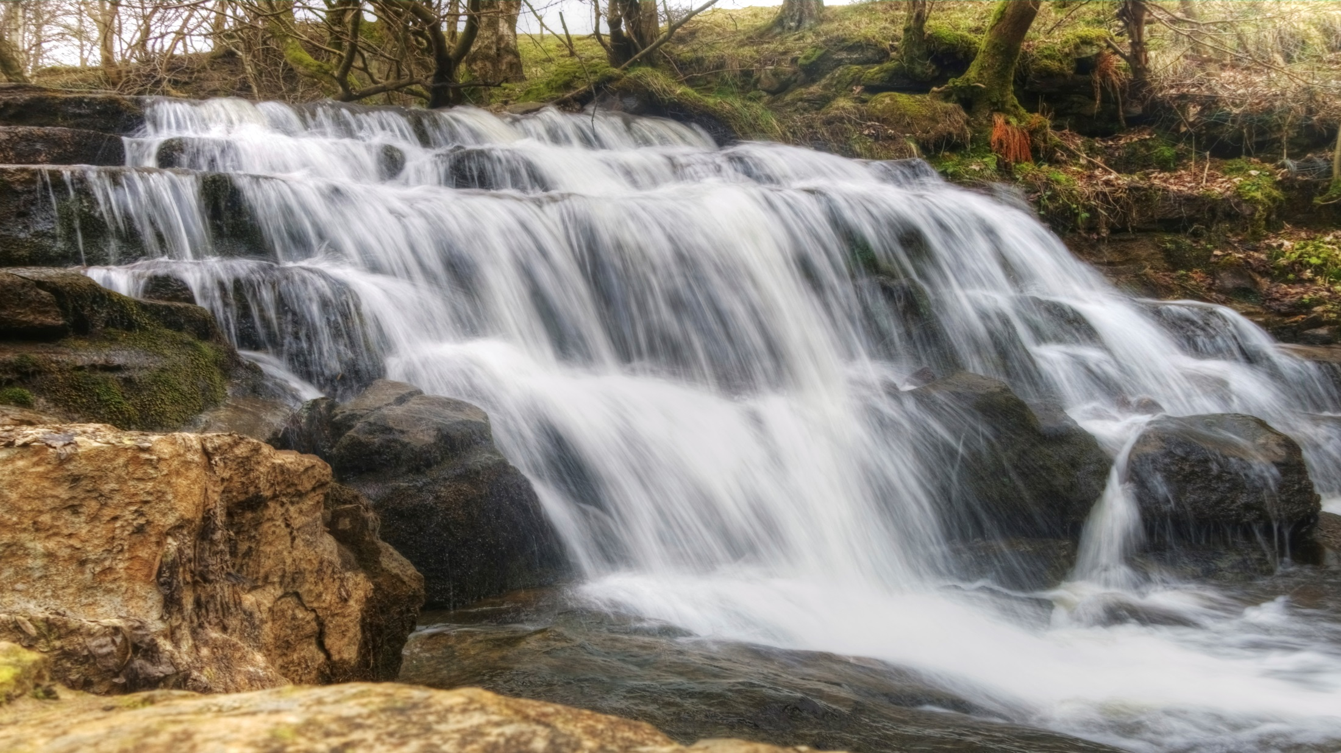

Slide 2
Going With The “Flow”

Slide 3
In this Trail, the nature of your calling as a knight will be explored and the motivation it provides to the knight to positively influence forest life will be examined.
A knight’s true calling follows the design God has for him which allows his life to “flow” ² (when he lives within God’s design).
In order to experience the flow that is a result of following his calling, a knight needs to do the following:
A. He must regularly participate in activities which challenge him and are at the higher end of his capabilities.
B. The challenge must require significant effort on his part, allowing nothing to be held back.
² Czikszentmihalyi (1990) did research on what he called “flow.”

Slide 4
In order to experience the flow that is a result of following his calling, a knight needs to do the following:
C. The skills that are required to fulfill his calling must be realistic, and he should be constantly seeking to improve himself.
D. God’s call always balances a knight’s skills with the challenges that are ahead.
If the challenge is less than what he is capable of, he is likely to become bored. If it is too difficult, he is likely to become frustrated.
E. His calling must be connected to clearly defined targets which allow success
and failure to be measured.
F. His call is comprised of a series of mini-goals which are focused on a larger purpose.

Slide 5
In order to experience the flow that is a result of following his calling, a knight needs to do the following:
G. All of the elements within the knight must be integrated in order for him to succeed.
This doesn’t allow for conflicting objectives or ambivalence, for it requires him to focus
on a single objective.
H. He must continually evaluate whether he is moving toward his calling or away from it.
I. He seeks immediate feedback and willingly shifts his performance as a result of it.
J. He recognizes that his relationship with God is the ultimate source of his power and strength.

Slide 6
When a knight is following his call:
The intensity of the forest activities related to his calling causes him to feel fully engaged.
The mundane parts of life are put aside in order to fully focus on his calling, as the miraculous becomes expected.
Simple details and practical applications can take on extraordinary importance because of their relevance to his objective.
His attention narrows; all that matters is the achievement of his call.

Slide 7
When a knight is following his call:
E. His awareness of time diminishes as each moment becomes sacred.
F. He becomes “one” with the activities related to his calling,
so much so that his identity in the moment blends with the tasks at hand. He wants to do what he is doing.
G. His motivation to participate in the activity is high because it comes from deep within him, almost automatically.

Slide 8
When a knight is following his call:
H. He becomes lost within the bigger picture as he follows what God has asked him to do.
I. He feels utilized by God, as he reflects on God’s presence to those he loves.
J. He feels a great sense of adventure as he works hard to make what seems impossible, possible.

Slide 9
His character and the flow that was a result of following his calling provided safety for Ruth and became a model for years to come.
(Ruth 2; 4:1-11)

Slide 10
As a result of serving others through his calling, the knight:
A. Learns what it is like to be deeply connected to God and guided by Him.
B. Is aware of the difference between when he is connected to God and when he is walking his own way.
C. Seeks forgiveness when he takes forest detours, for the Godly path is now more attractive to him.
D. Experiences great joy, as he is filled with the excitement
that comes from following his call.

Slide 11
As a result of serving others through his calling, the knight:
E. Understands that the activity of serving God well is as much a motivator
as seeing the ways that others benefit from his actions.
F. Willingly suspends any concerns that he has, which allows him to confidently take the risks that are required for transparency.
G. Has a calmness of spirit that others can feel, as his “game slows down,”
self-consciousness disappears, and he pursues his calling.
H. Naturally mentors others who want to follow their calling in ways that
are similar to his.
I. Values his time and ignores anything that contradicts his calling.

