Slide 1
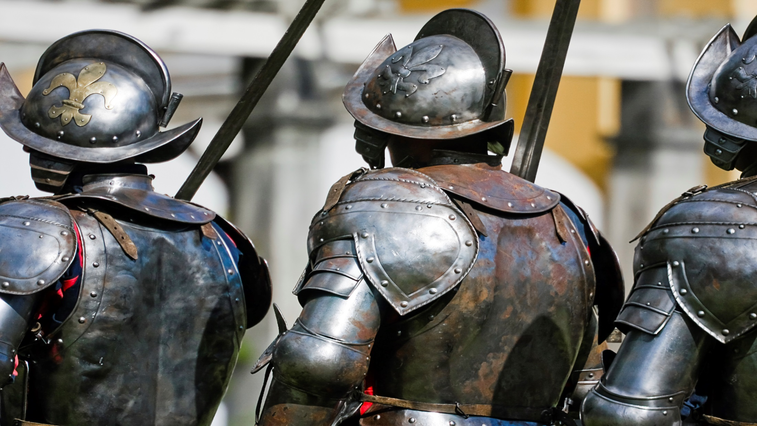
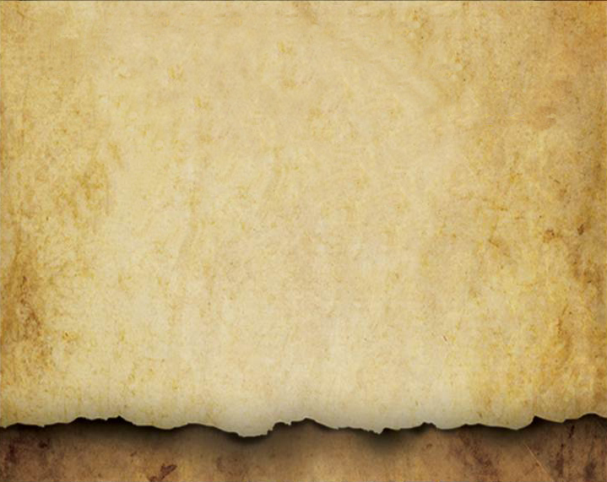
The rebuilding of the temple could be safely completed because of one faithful knight.
(Zechariah 4:6-10)

