Slide 1
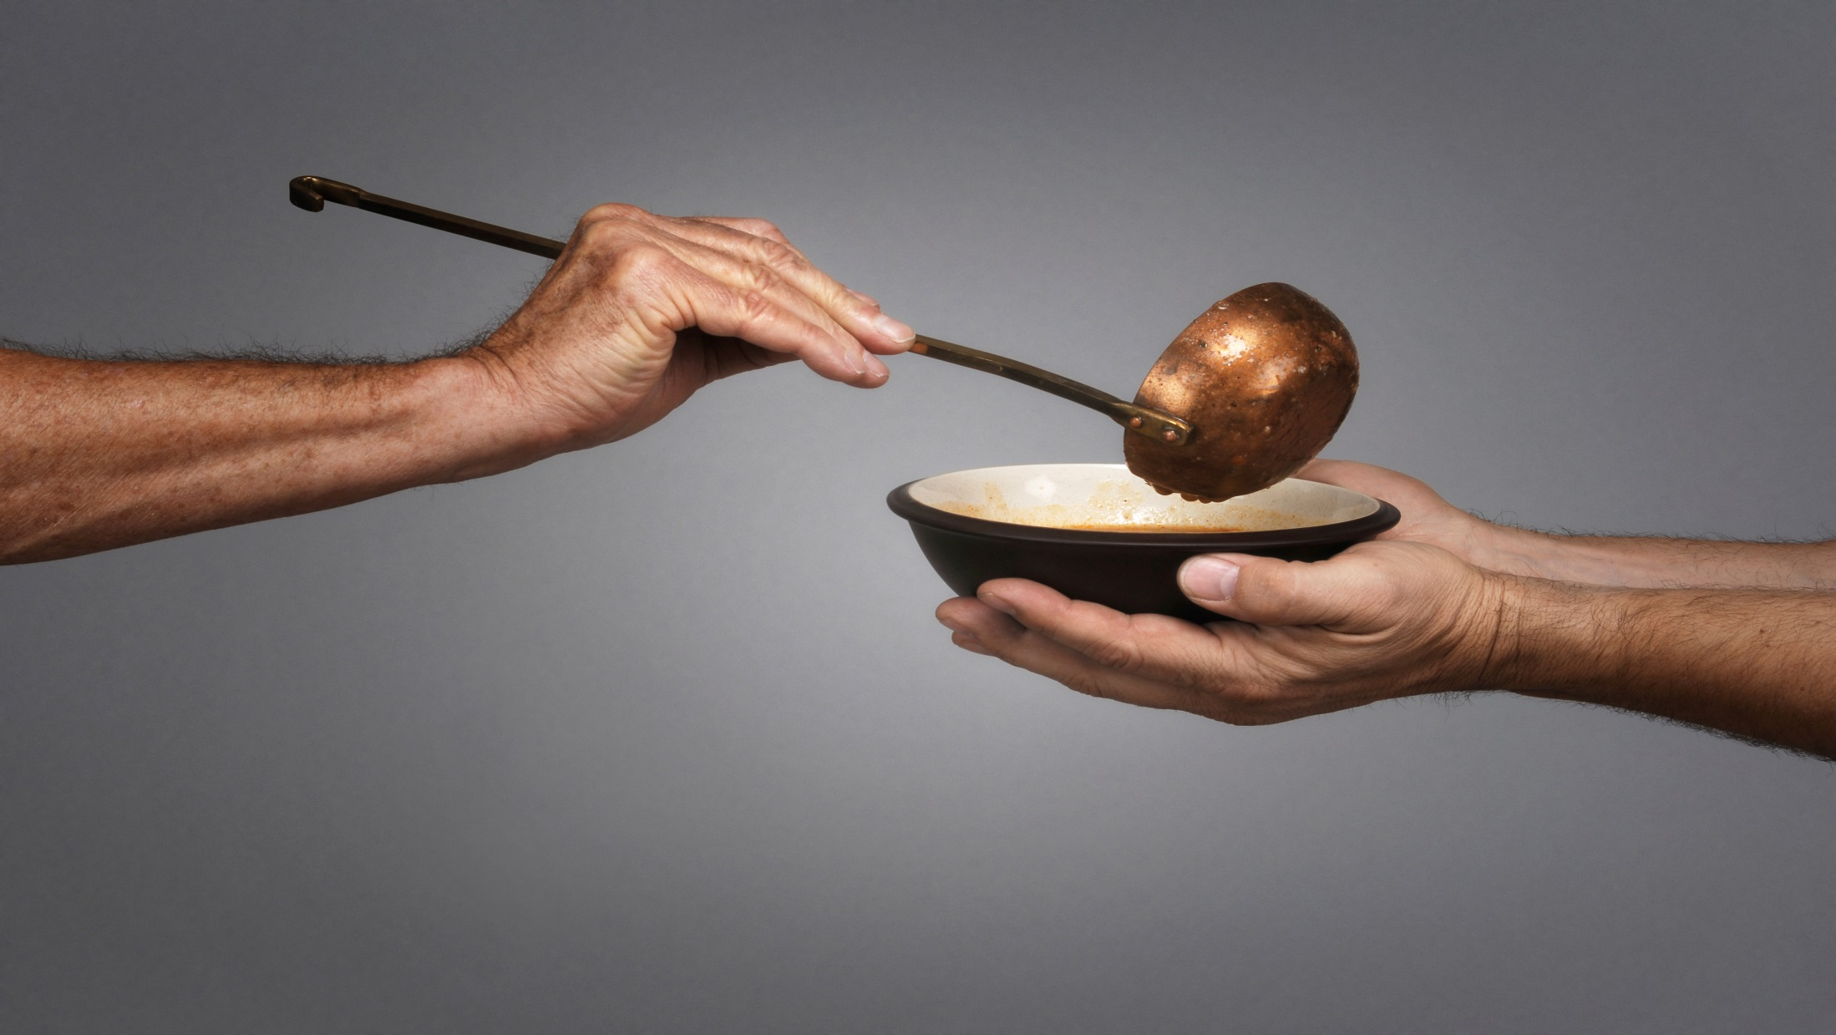

Slide 2
Difficult Questions

Slide 3
It is the duty of the knight to protect the hearts of women and children and to assist other males with their manhood journey. To do this, a knight must rely on his band of brothers (knights) to encourage, strengthen, confront and advise him.
In this Trail we will explore the application of the knightly characteristics that were described in the previous Trail, as the man strives to meet the needs of others.

Slide 4
Each person you have a relationship with has a series of needs that occur as part of their human development.¹ The more understanding you have of these needs, the easier it is to positively influence their lives. As these needs are satisfied, the intensity of the needs drops off.
1 These typical human needs were first discussed by Abraham Maslow in his theory of a hierarchy of human needs.

Slide 5
Think about the people you are close to. Grade yourself on a scale of 1 to 5:
1=Insensitive or self-centered
5=The most knightly way to act in a specific situation
A. A knight assists others with their physiological needs. Along with air and water, those we love have other biological needs which must be met in order to ensure their survival.
1. What kinds of food do you eat? What kind of food do you give to others? Is it healthy or unhealthy food? ___ (nutritionally healthy)

Slide 6
Think about the people you are close to. Grade yourself on a scale of 1 to 5:
1=Insensitive or self-centered
5=The most knightly way to act in a specific situation
A. A knight assists others with their physiological needs. Along with air and water, those we love have other biological needs which must be met in order to ensure their survival.
2. A knight is aware of the clothing and shelter needs of others.
How does a knight deal with temperature-related issues in his environment? Is he aware that he is more likely to feel warm at the same temperature that most women feel cold? How does a knight respond to this difference? ___ (considerate partner)

Slide 7
Think about the people you are close to. Grade yourself on a scale of 1 to 5:
1=Insensitive or self-centered
5=The most knightly way to act in a specific situation
A. A knight assists others with their physiological needs. Along with air and water, those we love have other biological needs which must be met in order to ensure their survival.
2. A knight is aware of the clothing and shelter needs of others.
Does the knight recognize that the environment that he provides to others affects their sense of well-being? ___ (sensitive partner)

Slide 8
Think about the people you are close to. Grade yourself on a scale of 1 to 5:
1=Insensitive or self-centered
5=The most knightly way to act in a specific situation
A. A knight assists others with their physiological needs. Along with air and water, those we love have other biological needs which must be met in order to ensure their survival.
2. A knight is aware of the clothing and shelter needs of others.
Does the knight recognize that the type/style of clothing that is available to his wife or children may be more important to them than it is to him? ___ (accepts differences)

Slide 9
Think about the people you are close to. Grade yourself on a scale of 1 to 5:
1=Insensitive or self-centered
5=The most knightly way to act in a specific situation
A. A knight assists others with their physiological needs. Along with air and water, those we love have other biological needs which must be met in order to ensure their survival.
3. There is a biological need for touch, for comfort and for sexual contact.
What happens when a woman wants physical comfort from a knight without sexual contact? ___ (respecting personal boundaries)

Slide 10
Think about the people you are close to. Grade yourself on a scale of 1 to 5:
1=Insensitive or self-centered
5=The most knightly way to act in a specific situation
A. A knight assists others with their physiological needs. Along with air and water, those we love have other biological needs which must be met in order to ensure their survival.
3. There is a biological need for touch, for comfort and for sexual contact.
How physically demonstrative are you regarding the ways that you show that you value others? (e.g., hug, smile, handshake) ___ (encouraging others)

Slide 11
Think about the people you are close to. Grade yourself on a scale of 1 to 5:
1=Insensitive or self-centered
5=The most knightly way to act in a specific situation
A. A knight assists others with their physiological needs. Along with air and water, those we love have other biological needs which must be met in order to ensure their survival.
4. The people in the knight’s life need to live a life that is balanced with proper medical care and adequate exercise in order to care for their physical bodies.
What kind of model is the knight in regard to taking care of his body? ___ (physical integrity)

Slide 12
Think about the people you are close to. Grade yourself on a scale of 1 to 5:
1=Insensitive or self-centered
5=The most knightly way to act in a specific situation
B. A knight assists others with their need for safety:
1. The people who are in the knight’s life want emotional security; they also look to the knight to provide an orderly world, one that makes sense where justice can be found and where chaos is minimal. A knight is called to lead.
In what ways do you provide stability to others? Can they feel the stability that you provide through your plans, principles, personhood and leadership? ___ (strength of character)

Slide 13
The security provided by a true warrior should never be taken lightly.
(2 Samuel 3:6-12)

Slide 14
Think about the people you are close to. Grade yourself on a scale of 1 to 5:
1=Insensitive or self-centered
5=The most knightly way to act in a specific situation
B. A knight assists others with their need for safety:
2. A knight meets the financial security needs of others.
How does each of the following protect the livelihood of those you feel responsible for: work ethic, savings and investments, financial planning, insurance choices, impulse control, disability accommodations, estate planning and will? ___ (practical leadership)

Slide 15
Think about the people you are close to. Grade yourself on a scale of 1 to 5:
1=Insensitive or self-centered
5=The most knightly way to act in a specific situation
B. A knight assists others with their need for safety:
3. A knight is aware of the personal security needs of others. He pro-actively protects them from violence, abusive actions, manipulations, mistruths, past painful memories and the negative definitions they have of themselves.
When you walk up to someone you know, do they appear relaxed; do they feel safe; are they looking forward to having fun; do they willingly talk about what they are struggling with; do they seek your encouragement? ___ (emotional intelligence)

Slide 16
Think about the people you are close to. Grade yourself on a scale of 1 to 5:
1=Insensitive or self-centered
5=The most knightly way to act in a specific situation
C. A knight assists others with their need for love:
1. A knight prioritizes his relationships according to the level of intimacy he wants and his commitment to the relationship. This allows those who are closest to him to trust that he will take care of them in all circumstances.
Would the people you love the most say that you treat them like they are a priority? Do you invest your time in them? ___ (reliable friend)

Slide 17
Think about the people you are close to. Grade yourself on a scale of 1 to 5:
1=Insensitive or self-centered
5=The most knightly way to act in a specific situation
C. A knight assists others with their need for love:
2. A knight practices L.A.R.G.E. C.A.R.E. with the people he is closest to:
He listens to them.
He gives them his attention.
He respects them.

Slide 18
Think about the people you are close to. Grade yourself on a scale of 1 to 5:
1=Insensitive or self-centered
5=The most knightly way to act in a specific situation
C. A knight assists others with their need for love:
2. A knight practices L.A.R.G.E. C.A.R.E. with the people he is closest to:
He is genuine when he interacts with them.
He invests energy in their relationship.
He communicates clearly.

Slide 19
Think about the people you are close to. Grade yourself on a scale of 1 to 5:
1=Insensitive or self-centered
5=The most knightly way to act in a specific situation
C. A knight assists others with their need for love:
2. A knight practices L.A.R.G.E. C.A.R.E. with the people he is closest to:
He demonstrates affection.
He acts responsibly.
He shows empathy.

Slide 20
Think about the people you are close to. Grade yourself on a scale of 1 to 5:
1=Insensitive or self-centered
5=The most knightly way to act in a specific situation
C. A knight assists others with their need for love:
2. A knight practices L.A.R.G.E. C.A.R.E. with the people he is closest to:
Do you encourage others to grow and change? Do you allow them to relate in new or different ways than they have in the past? ___ (relationally flexible)
Are people better off having had you in their lives? ___ (relationally skilled)

Slide 21
Think about the people you are close to. Grade yourself on a scale of 1 to 5:
1=Insensitive or self-centered
5=The most knightly way to act in a specific situation
C. A knight assists others with their need for love:
3. A knight allows himself to become vulnerable and engages others by relating to their thoughts and feelings.
Are you open to your campfire group members in a manner that allows them to truly become a part of your life? ___ (active participant)

Slide 22
Think about the people you are close to. Grade yourself on a scale of 1 to 5:
1=Insensitive or self-centered
5=The most knightly way to act in a specific situation
C. A knight assists others with their need for love:
3. A knight allows himself to become vulnerable and engages others by relating to their thoughts and feelings.
Do you learn as much from listening to others and considering their perspectives as you do from sharing your own thoughts? ___ (curious learner)

Slide 23
Think about the people you are close to. Grade yourself on a scale of 1 to 5:
1=Insensitive or self-centered
5=The most knightly way to act in a specific situation
D. A knight assists others with their need for self-esteem:
1. A knight responds in ways that help others feel valued, respected and significant.
Do others feel better or worse about life and themselves after they interact with you? ___ (supportive presence)

Slide 24
Think about the people you are close to. Grade yourself on a scale of 1 to 5:
1=Insensitive or self-centered
5=The most knightly way to act in a specific situation
D. A knight assists others with their need for self-esteem:
2. A knight shows gratitude freely; he compliments others regularly, recognizing that everyone needs verbal hugs.
Do you tell others regularly what they are good at? ___ (encouraging attitude)

Slide 25
Think about the people you are close to. Grade yourself on a scale of 1 to 5:
1=Insensitive or self-centered
5=The most knightly way to act in a specific situation
D. A knight assists others with their need for self-esteem:
3. A knight realizes that everyone is different; there are times when he must change his way of looking at things in order to appreciate the personal style and interests of others.
Would women, children and other men describe you as someone who can appreciate and celebrate interpersonal differences? ___ (non-judgmental openness)

Slide 26
Think about the people you are close to. Grade yourself on a scale of 1 to 5:
1=Insensitive or self-centered
5=The most knightly way to act in a specific situation
D. A knight assists others with their need for self-esteem:
4. A knight knows that the recognition of another person through a nod, a handshake or a greeting helps them feel recognized. In Africa, a person may say, “Sawa bona” (I see you) and another person may respond by saying, “Sikhona” (I am here). These are natural human responses that emphasize our human connection and affirm our existence.
How often do you reach out to others by choosing to set aside what you are thinking about, or by setting aside your own agenda in order to be present for them? ___ (showing that you value your relationships)

Slide 27
Think about the people you are close to. Grade yourself on a scale of 1 to 5:
1=Insensitive or self-centered
5=The most knightly way to act in a specific situation
E. A knight assists others with their self-actualization needs which encourages them to be authentic:
1. A knight encourages others in their own self-development by being a model, a coach and teacher.
Can others identify specific ways that you have helped them to develop their potential and become what God has called them to be? ___ (inspiring essence)

Slide 28
Think about the people you are close to. Grade yourself on a scale of 1 to 5:
1=Insensitive or self-centered
5=The most knightly way to act in a specific situation
E. A knight assists others with their self-actualization needs which encourages them to be authentic:
2. A knight provides opportunities for the people he loves to succeed in areas that are outside of his skill set.
How do you handle the success of others? Is your natural reaction to be competitive with others or to celebrate with them? ___ (appreciative companion)

Slide 29
Think about the people you are close to. Grade yourself on a scale of 1 to 5:
1=Insensitive or self-centered
5=The most knightly way to act in a specific situation
E. A knight assists others with their self-actualization needs which encourages them to be authentic:
3. A knight has high expectations of those around him, despite the fact that they may not feel the same way. He believes in their potential and willingly confronts the behavioral choices they make which might demean them and limit their success.
Are you willing to create tension in your relationships by confronting others when they are making choices that will hurt them? ___ (challenging teammate)

Slide 30
Think about the people you are close to. Grade yourself on a scale of 1 to 5:
1=Insensitive or self-centered
5=The most knightly way to act in a specific situation
F. When a knight has met his own needs, he is more willing to meet the needs of others. He recognizes that each person has their own chain mail filters which cause them to re-experience past issues. He accepts, as his knightly quest, the obligation to help others learn to be their best. ___ (loves deeply)

Slide 31
Total Score: ___
Challenge question: As a knight, to how many people do you feel an obligation to ensure that their needs are met? ___ (sensing a social responsibility)

