Slide 1
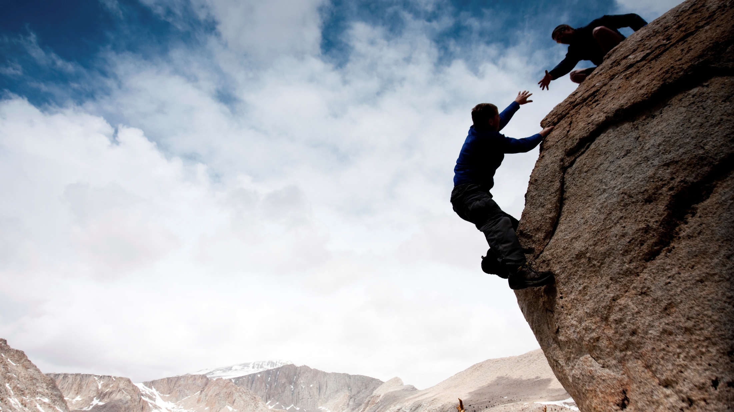

Slide 2
I Can Rely
On You

Slide 3
Principle 10
“A man accepts that to live is to be challenged through crisis and hardships.”

Slide 4
Think about one of your most important friendships. For each statement below, check whether you agree or disagree that this attribute is an accurate description of this relationship.

Slide 5
I want my friend to demonstrate LARGE CARE in our relationship. Therefore, I want to experience being:
1. Listened to in a non-judgmental fashion. I want to feel understood and hear myself reflected accurately in his/her words.

Slide 6
I want my friend to demonstrate LARGE CARE in our relationship. Therefore, I want to experience being:
2. Given attention. I want my friend to show me that I am significant to him/her and, by making our relationship a priority, that I matter to him/her.

Slide 7
I want my friend to demonstrate LARGE CARE in our relationship. Therefore, I want to experience being:
3. Respected. We each appreciate the ways that we are different as well as the ways we are similar. S/he encourages me to explore and accept my individuality.

Slide 8
I want my friend to demonstrate LARGE CARE in our relationship. Therefore, I want to experience being:
4. Treated genuinely. I want my friend to be authentic and real. I attempt to express my true self by gaining more insight into my core messages.

Slide 9
I want my friend to demonstrate LARGE CARE in our relationship. Therefore, I want to experience being:
5. Energy invested. My friend seeks me out and is willing to enter the less pleasant areas of my life. I recognize that I am not alone when his/her energetic “presence” is with me.

Slide 10
I want my friend to demonstrate LARGE CARE in our relationship. Therefore, I want to experience being:
6. Communicated with. My friend clearly tells me what s/he expects and thinks about our relationship. I learn from his/her viewpoint regarding the forest and myself.

Slide 11
I want my friend to demonstrate LARGE CARE in our relationship. Therefore, I want to experience being:
7. Shown affection. My friend lets me know through handshakes, body language, eye contact, and non-sexual touch that he cares. I desire to express my love for my sexual partner in non-sexual ways. I feel invested in and am valued by another.

Slide 12
I want my friend to demonstrate LARGE CARE in our relationship. Therefore, I want to experience being:
8. Responsibly assisted. My friend plans part of his/her life around our relationship. S/he can be reliably expected to be there when I am in need. I expect his/her assistance on practical life issues.

Slide 13
I want my friend to demonstrate LARGE CARE in our relationship. Therefore, I want to experience being:
9. Given empathy. My friend tries to feel my internal world. I am not threatened or fearful of expressing my struggles because I am understood.

Slide 14
The following are attributes that you should expect from a FRIEND. A friend will:
10. Forgive. A friend understands that it is inevitable that I will fail him. When I am imperfect, s/he allows me to restore the relationship.

Slide 15
The following are attributes that you should expect from a FRIEND. A friend will:
11. Be realistic. S/he gives the gift of feedback and confrontation. This encourages me to live in a way that is truthful, generates self-respect, and encourages my potential.

Slide 16
The following are attributes that you should expect from a FRIEND. A friend will:
12. Inspire. S/he supports my desire to seek God and encourages spiritual awareness. S/he helps me keep my relationship with God a priority.

Slide 17
The following are attributes that you should expect from a FRIEND. A friend will:
13. Share enjoyment. S/he provides laughter and fun to my life. S/he helps me refuel for the next forest challenge ahead of me.

Slide 18
The following are attributes that you should expect from a FRIEND. A friend will:
14. Provide new learning. S/he encourages me to understand a variety of forest circumstances that I must confront at a deeper level. S/he encourages me to constantly refine my perspective on life.

Slide 19
“A friend may well be reckoned the masterpiece of nature.”
Ralph Waldo Emerson

Slide 20
The following are attributes that you should expect from a FRIEND. A friend will:
15. Serve with dedication. S/he provides me with loyalty and dependability that instills a deep sense of trust. S/he “does life” with me. Despite my failures, I am not left alone.

Slide 21
Write the names of five of your friends below. Look over the 15 characteristics of a LARGE CARE FRIEND. After each name, list the number(s) of the attributes listed in this chapter that s/he does particularly well. Are there any attributes s/he could do better?

