Slide 1
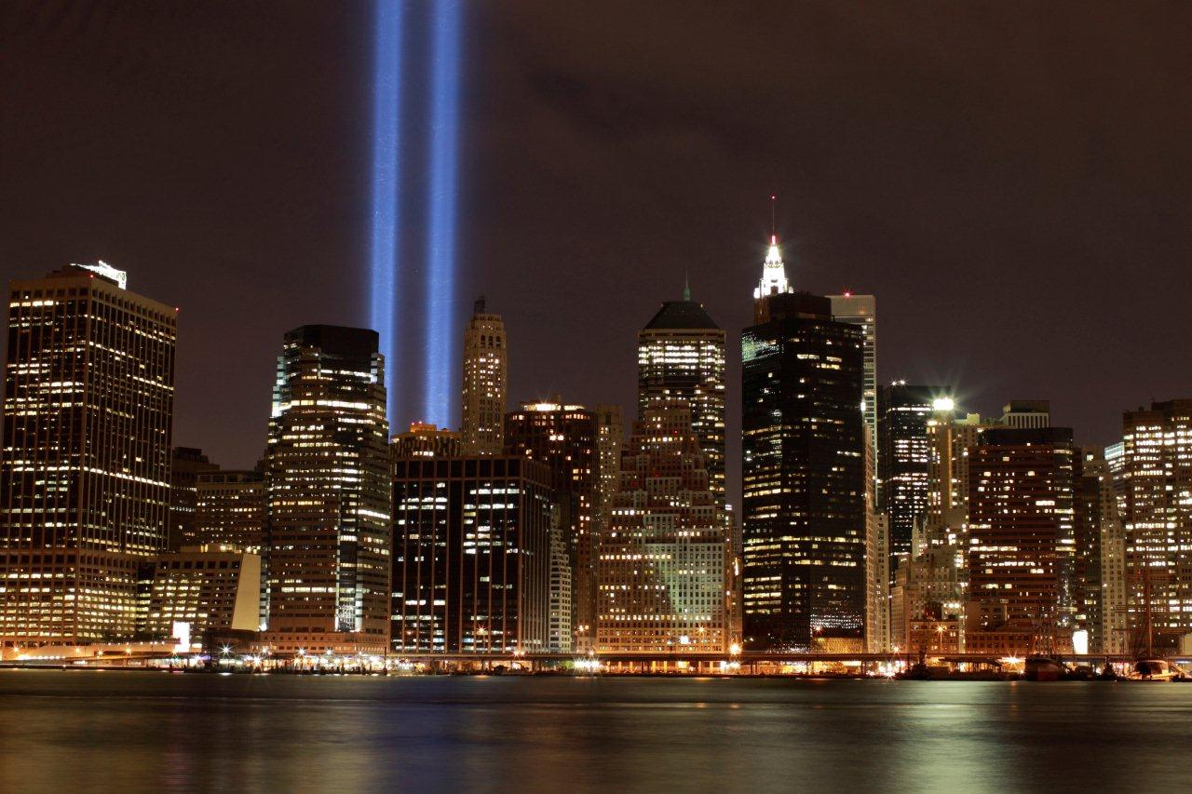

Slide 2
Being the
Message

Slide 3
A knight’s personal call needs to be known and followed for his life to have its greatest impact.
I. The call of the knight is heard by:

Slide 4
A. Reviewing one’s history.
I liked school.
What subjects did you like?
What did you like to read ?
In what areas did practice seem worth it?

Slide 5
A. Reviewing one’s history.
What did you admire about certain role models when you were growing up?
Dad
Mother
Siblings
Other

Slide 6
A. Reviewing one’s history.
What early childhood dreams were used to pass the time?
What TV shows did you not want to miss and what were the themes?
What type of play did you most enjoy as a child?

Slide 7
A. Reviewing one’s history.
If you remember a time when your dream was “stepped on,” describe it.
In what areas did your peers look to you to take the lead or assume you would know what to do?

Slide 8
A. Reviewing one’s history.
What did you want to be and do when you grew up? Was this supported by your family and/or friends?

Slide 9
“Do you wish to rise? Begin by descending. You plan a tower that will pierce the clouds? Lay first the foundation of humility.”
Saint Augustine

Slide 10
B. Looking at what you believe you would have been like if you had been properly supported:
If parents were more positive in defining you.
If “significant others” would have been supportive.

Slide 11
B. Looking at what you believe you would have been like if you had been properly supported:
If life circumstances had been different.
4. If your parents were more mature and able to offer wisdom and support.

Slide 12
C. Knowing what your current life themes and desires are.

Slide 13
II. To see your call in present day life, you must:
Take time to reflect on how life is experienced.
Be creative by trying different types of positive experiences.

Slide 14
II. To see your call in present day life, you must:
Listen to the supportive messages of others.
D. Give to others in ways that make their lives better.

Slide 15
II. To see your call in present day life, you must:
Look for honest feedback from each experience.
Take the first step in fulfilling your passion.
Spend time asking for God’s direction.

Slide 16
“Your wife, Elizabeth, will give you a son… And he will turn many Israelites to the Lord their God.”
Luke 1:13 & 16

Slide 17
III. As you prepare for the next step in following your call, you must realize:
A. That between you and the achievement of your call are difficulties that will prepare you to fulfill that call.
You will need others to support your call.

Slide 18
III. As you prepare for the next step in following your call, you must realize:
That your call is God’s gift to you for both self discovery and personal contentment.
There is no insignificant call.

Slide 19
III. As you prepare for the next step in following your call, you must realize:
That a call always includes some form of service that benefits others.
Your call may change in expression as you reach different life stages.

Slide 20
III. As you prepare for the next step in following your call, you must realize:
G. A call provides a man with a sense of:
1. Meaning.
2. The importance of time.
3. The significance of his choices.

Slide 21
III. As you prepare for the next step in following your call, you must realize:
A call provides a man with a sense of:
The necessity for self maintenance and care.
The need for evaluating relationships.
The value of resiliency.

Slide 22
III. As you prepare for the next step in following your call, you must realize:
A call’s fulfillment requires God’s guidance and grace.
God knows your design intimately.
He wants to empower you to reflect his love to the forest.

