Slide 1
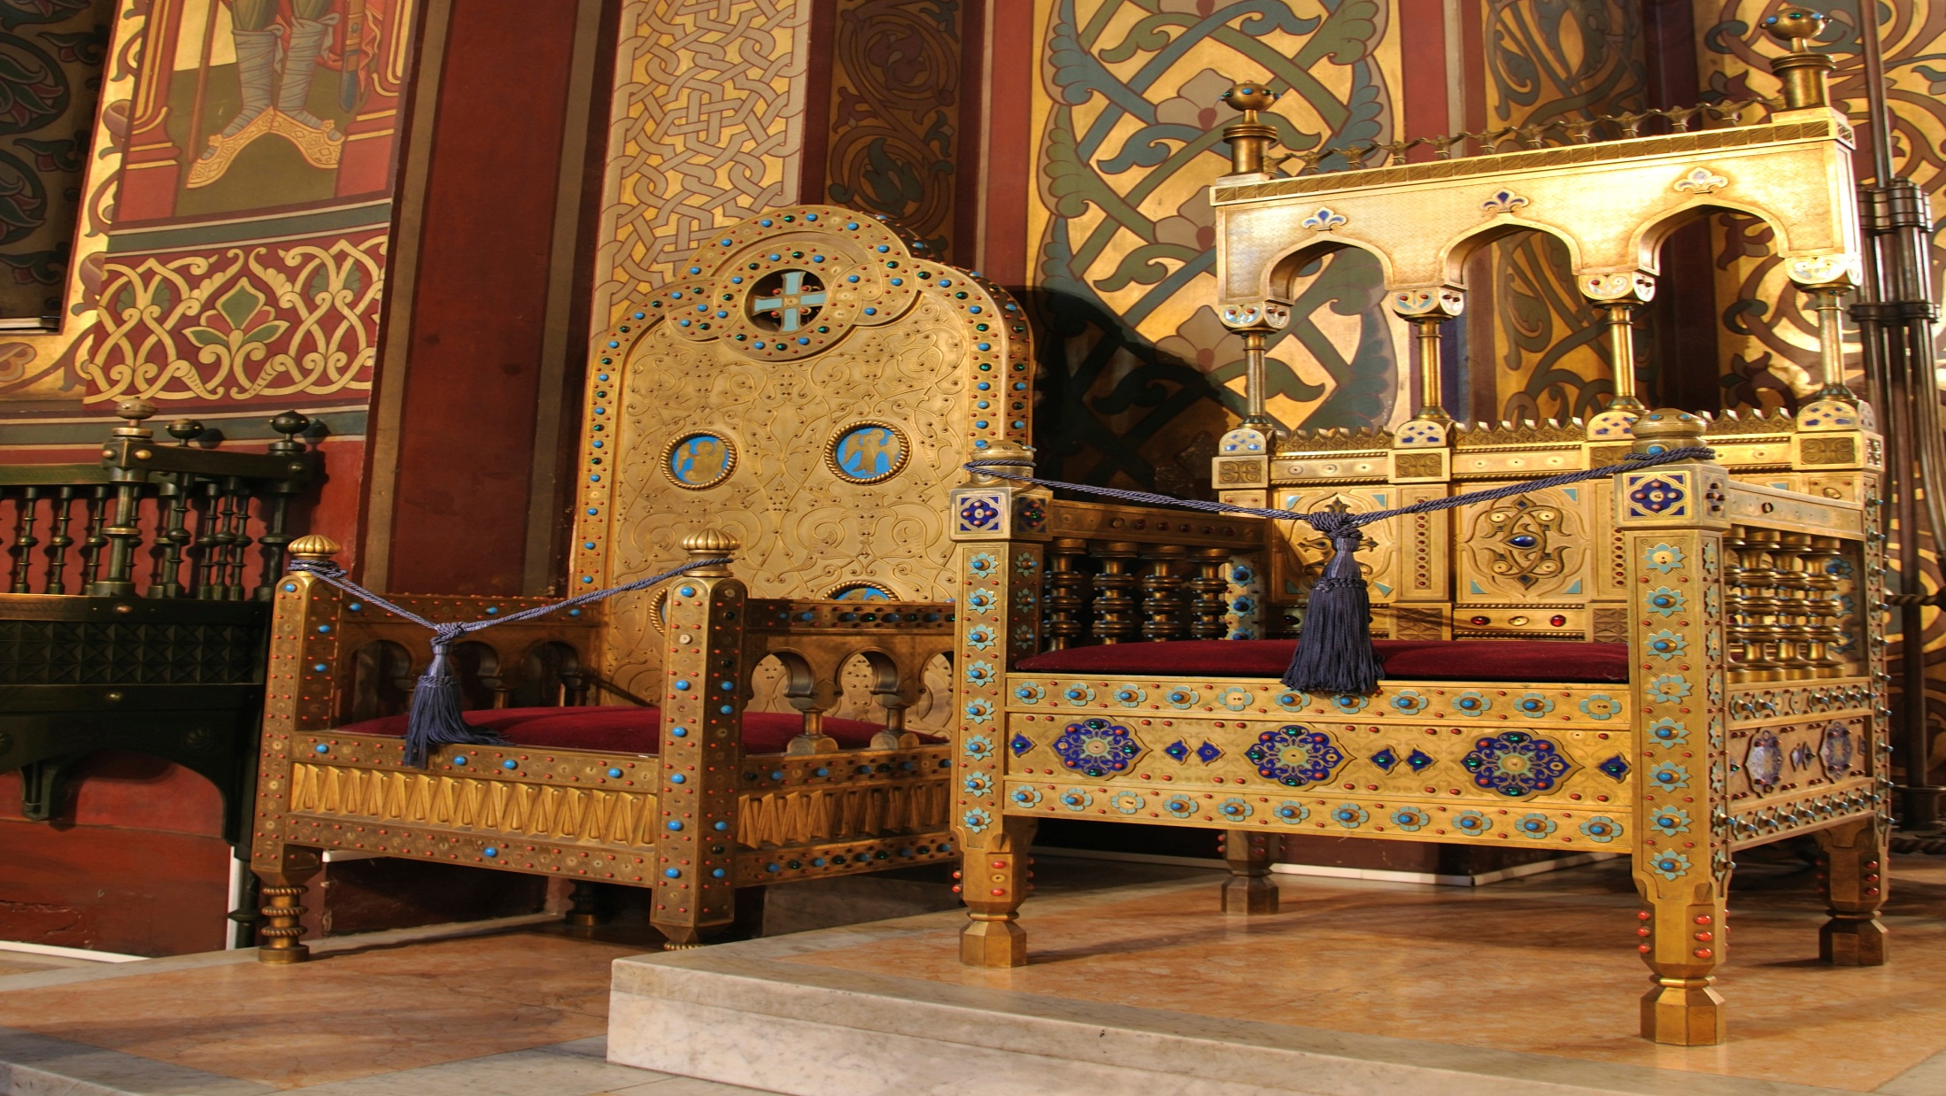

Slide 2
Chip off The Old Block

Slide 3
Principle 6 –
“A man is dedicated to continuously learning.”

Slide 4
Commitment to Change
I have/had a Dad.
I have/had a Mom.
I get to decide if I will be like them or not.

Slide 5
Write your chain mail score from last week (___) and trace some of its content to the experiences you had with your Mom and Dad. Remember, wounds that are not dealt with, will continuously repeat themselves and will be passed on to others whom we love. Knights have the courage needed for reflection and change at deeper levels.

Slide 6
Score each parent on a scale of 1 (often) to 5 (seldom) on how they demonstrated each of the attributes listed below. 1 = often / 5 = seldom

Slide 7
1. Mother/Father showed a high
motivation to create
supportive relationships.
2. Mother/Father appeared to be
a loyal and giving friend to
others.
3. Mother/Father spent time with
friends and participated in
activities apart from me.

Slide 8
4. Mother/Father seemed to be fairly easy-going and relaxed.
5. Mother/Father trusted me to do what was good and right.

Slide 9
“A strong conviction that something must be done is the parent of many bad measures.”
Daniel Webster

Slide 10
6. Mother/Father disciplined me fairly.
7. Mother/Father listened to me and seemed to understand me.
8. Mother/Father had a fun sense of humor.
9. Mother/Father spent quality time with me (reading, playing, watching my team sports, etc).

Slide 11
10. Meal times with my Mother/Father were positive times of conversation and family interaction.
11. Mother/Father encouraged me to take appropriate risks for new opportunities, try new things, and explore my interests.
12. Mother/Father expressed their anger clearly and lovingly when I failed to live up to their expectations.

Slide 12
13. Mother/Father forgave me when I made bad choices.
14. Mother/Father worked to discover my feelings and responded in a way that I felt understood.
15. Mother/Father communicated their realistic expectations of what my behavioral choices should be.

Slide 13
16. Mother/Father both encouraged and assisted me in my learning process.
17. Mother/Father talked to me about what they thought about life.
18. Mother/Father modeled positive ways to deal with interpersonal conflict.
19. Mother/Father demonstrated ways to “refuel” and take care of themselves.

Slide 14
20. Mother/Father lived a disciplined lifestyle and were not dominated by compulsive or addictive behaviors (sexual, food, alcohol, drugs, and work behaviors).
21. Mother/Father acted in a confident manner and exhibited a hopeful attitude.
22. Mother/Father demonstrated the ability to set goals and work toward the successful completion of these goals.

Slide 15
23. Mother/Father were optimistic and expressed negative thoughts minimally.
24. Mother/Father were active in their own interests and enjoyed life.
25. Mother/Father were honest in their interactions with others and used their personal power appropriately.

Slide 16
26. Mother/Father were able to adapt to the forest’s need for change by demonstrating flexibility and wisdom.
27. Mother/Father seemed to appropriately balance their concern for themselves and their concern for others.
28. Mother/Father were able to relate easily to individuals who were different from them.

Slide 17
29. Mother/Father demonstrated a strong work ethic.
30. Mother/Father viewed their spirituality as an asset and modeled their spiritual viewpoint consistently within the home.
*Add up the scores for:
Mom _____ Dad _____ Step _____
Last week’s chain mail score: _________

Slide 18
How similar or different are you from each parent? Check one of the following:
I am like Mom. ___
I am not like Mom. ___
I am like Dad. ___
I am not like Dad. ___
I am like/unlike Step-parent. ___ (circle one)

